Slide 1
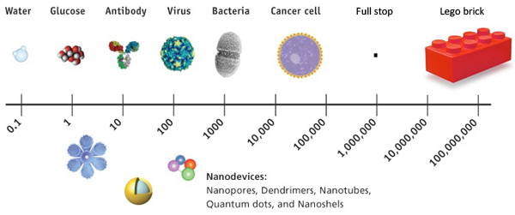
Cumulative summary of nanoscience content
India Scott

Slide 2
Nanoscience
The study of unique properties of matter at the nanoscale; an interdisciplinary field of science combining physics, materials science, the chemistry of complex molecules, and related disciplines (generally 1-100 nm). (http://www.nano.gov/about-nni/glossary)
Some sites specify that it is the study of materials and systems whose structures and components exhibit novel phenomena and processes due to their nanoscale size. (http://nanoengineering.ucsd.edu/about-us/mission-statement)
Concepts associated with Nanoscience:
Size and scale
Surface area-to-volume ratio
Electromagnetic and gravitational force
Models
Size-dependent properties
Self-assembly.

Slide 3
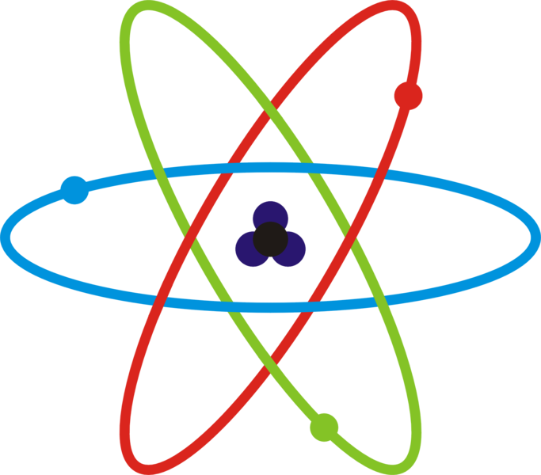
Size and Scale
There exist four “worlds” in which things fall based on their size.
Macro Micro Nano Atomic
Things at the nanoscale are 10^-9 meters in size!
In comparison to everyday life in the macro world, working in and thinking about nanoscale can be hard to digest.

Slide 4
Size and Scale
Through the “How Big Is It?” activity we were able to compare and arrange items on the macro-nano scale according to size.
Being able to understand how items in the different “worlds” relate to one another is important in understanding Nanoscience.
From Peter Bermel’s presentation, we saw how scaling the amount of silicon used in PV cells (from 200 microns to 2 microns) makes a significant difference in the amount of energy absorbed and reflected. Also how changing material, from silicon to PhC makes a difference.

Slide 5
Surface area-to-volume ratio
One idea of Nanoscience is to achieve a higher surface area-to-volume ratio.
The more area nano particles can cover, the more effective they are.
There exists an exponential relationship between surface area and volume as discovered in the SA/V ratio activity.

Slide 6
Surface area-to-volume ratio
Professor Wei’s presentation gave a look into how the amount of data stored and transmitted on a device increased although the area you were storing this data decreased. This is an example of how surface area-to-volume ratio impacts Nanoscience.

Slide 7
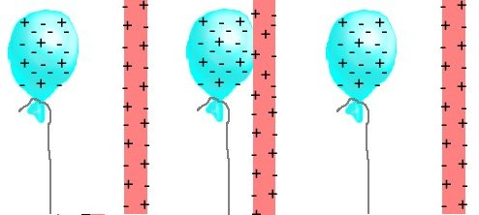
Forces
At the nanoscale, things can feel very counter intuitive.
At the macroscale, we know gravitational force to be the strongest force, BUT at the nanoscale, objects are so small Gravitational force becomes less relevant than Electromagnetic forces!
Being able to control and understand how those forces impact atoms and particles is important to Nanoscience because scientist want to be able to manipulate the way these forces affect those particle.

Slide 8
Forces
Gravitational Force
Attractive force
Varies as a function of the mass and distance between two objects
Electromagnetic Force
Can be attractive or repulsive
Varies as a function of the charge and distance between two objects

Slide 9
Forces
In the size-dependent properties lab, we saw that magnetite and ferrofluid sank to the bottom of their tubes due to gravity, but when exposing them to a magnet, they defied gravity and suspended in mid air.
The two substances are nanosize therefore, electromagnetic force is more powerful in acting on them than gravity.

Slide 10
Models
Working at the nanoscale is a very delicate process.
Being able to make models to represent what we see at the nanoscale is extremely beneficial to scientist!
Models allow scientists to experiment with nanoscale elements without compromising their integrity.

Slide 11
Models
Models like the Black Box activity helped us to model how scientists use Scanning Tunneling Microscopy (STM) to get an understanding of the topography of surface they cannot see.
The image to the right shows models used by researchers in Bermel’s presentation to get an understanding of light absorption through three different surfaces.

Slide 12
Size-dependent properties
We learned that properties of things at the macro scale can change at the nanoscale.
Intensive properties such as heat capacity and electrical conductivity can change at the nanoscale.
If we consider the gold station in the size dependent properties lab, we saw how 20-40nm gold nano particles responded differently to light than 80nm gold nano particles.

Slide 13
Size-dependent properties
These properties are important to Nanoscience because these properties will be the ones that affect the way in which these particles react under the experiments of scientists.
Professor Shakouri explained how the nanoscale is the most efficient scale for manufacturing. Knowing the properties of materials at this scale is necessary in achieving this efficient.

Slide 14
Self-Assembly
Self-assembly occurs naturally when particles come together to create something new while maintaining their original properties.
We see self-assembly in nature in things like snowflakes.
The Gummy Capsule activity was a good model for self-assembly. By controlling the environment we placed the sodium alginate in, we were able to mimic self-assembly.

Slide 15
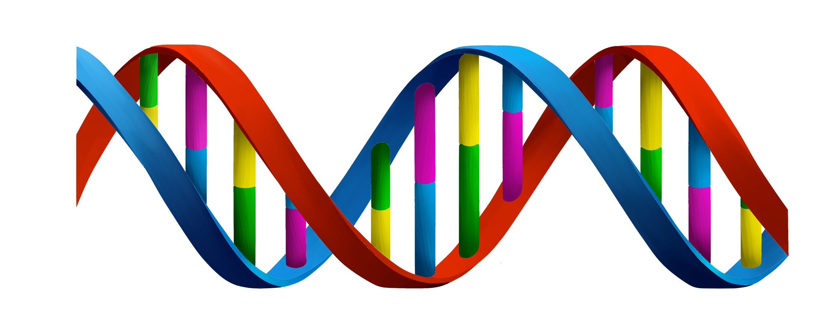
Self-Assembly
In Professor Shakouri’s presentation, he talked about the bottom up and top down approaches to self-assembly.
He offered DNA synthesis as an example of bottom up assembly.
Self-assembly becomes very important to scientists when they are able to control the assembly of particles for their needs by effectively controlling the environment.

Slide 16
Tying it all together
Nanoscience is about way more then making things or studying things that are tiny. There are many concepts and factors that tie into how scientists create and understand things at the nano scale. The concepts of size-dependent properties, SA/V ratio, electromagnetic and gravitational forces, and self-assembly are connected. As mentioned earlier on, scientist want to be able to increase the SA of substances without necessarily increasing the volume. This occurs naturally as the relationship between SA/V ratio is exponential. By increasing surface area, we decrease the size of our matter and often enter the nano scale. At the nano scale electromagnetic forces outweigh gravitational forces and size-dependent properties become more prevalent. With the help of special tools, scientists are able to manipulate and control particles on the nano scale. Through this manipulation scientist can mimic self-assembly!

Slide 17
Misconceptions
There are often misconceptions in scaling like when understanding a water molecule is smaller than a cesium atom or the height of Mt.Everest versus distance driven in a car after 1 hour.
The relationship between SA/V is directly proportional rather than exponential.
This can be addressed by giving students tools they can use to find these answers for themselves rather than telling them answers.
This is a misconception that can often be cleared up in SA/V ratio activity, but if further struggle exists using manipulatives to model SA/V could help.

Slide 18
misconceptions
Through the size-dependent properties activity, students may perceive all nano particles to be water resistance or repel all substances.
In the “Does It Pour Out” activity, students could have misconceptions about what reasons the water stays in the smaller tube. Assuming things like because the tube holds less water or made of a different material.
The hydrophobic nature of the nano particles in the activity allows them to repel substances. Introducing non-polar substances to the activity may prove that nano particles do not repel all substances.
This misconception can be addressed with further experimentation. Allow students to make claims and test them.

Slide 19
Instructional activities and Rationale
Self-Assembly Simulation
This activity served as a great hands on model for how particles assembly under different conditions.
Surface Area-to-Volume Ratio
This activity works well in helping students understand the exponential relationship between the SA/V ratio of objects and their lengths or radii. Understanding how the ratio increases as length decreases is important in creating nano particles.
How Big Is It?
The hands on nature of this activity helps students to be able to identify with things in the four “worlds” different. They get a better understanding of size and scale from working with tangible objects. The visual representation, incorporating things they are familiar with alongside those they may not know is beneficial to understanding size and scale.
Size-Dependent Properties
This activity allows students to see how the properties of things affected by nano particles change. In the t-shirt station alone, students see how nano particles are hyrdophic and can be used repel stains on clothing.

Slide 20
Questions
What relationships exist between math and nanoscience outside of equations and technology?
I believe I understand the concepts we’ve covered, but I am not still completely certain I am interpreting everything correctly; like if my understanding of it is the intended goal.Have a interpreted the fiber optics chart I included on my SA/V Ratio slide correctly?

